Slide 1
Section 3.5 Ratios and Problem Solving
© Copyright all rights reserved to Homework depot: www.BCMath.ca

Slide 2
Rate of Work Problems
One main concepts of this section is dealing with scenarios when you have one more people working together
Each person has a rate of how fast they work and you want to find out how long it takes for the job to be completed together
Ie: To paint a house alone, Sam would need 4 hours, Tim 6 hours, and Sara 5 hours. How long would it take for them to paint it together?
Think of these problems as percentages, each person does their part (percentage) to complete the job (100%)
Let “x” be the time that it takes to complete when working together
Sam
Tim
Sara
100% means that the job is complete
+
+
=
100%
The denominators are the individual times when working alone
Solve this equation for “x”

Slide 3
Sam
Tim
Sara
Multiply all terms by the LCD to cancel out the denominator
+
+
=
They all worked 1.35 hours together to finish the job
Sam did 1.35/4 = 33.78% of the job
Tim did 1.35/6 = 22.52% of the job
Sara did 1.35/5 = 27.02% of the job

Slide 4
Q1: Mike can mow his lawn in 2h and his brother Tim can mow in 4h. How long will it take if they work together?
Q2: Andy, Bob, and Chris are all trying to fill a large swimming pool using their own hose. Andy’s hose will take 8 hours along, Bob will take 9h, and Chris will take 10h. How long will it take to fill the pool together?
Q3: Suppose David brought is hose and adding him to the group will speed up the process to require only 2 hours. How long will it take for David to fill the pool himself?
Q4: Together, Larry and Stew can do a job in 72minutes. Individually, Larry takes an hour longer than Stew. How long does it take Larry to do the job by himself?
Q5: Sara and Jasmine are office cleaners. Sara earns $10/h and takes 12 hours to clean an office. Jasmine earns $12/h and takes 10 hours to clean it. How long will it take if they work together? Is the cost cheaper if they worked alone or together? By how much?

Slide 5
Ex: Mike can mow his lawn in 2h and his brother Tim can mow in 4h. How long will it take if they work together?
% of Mike’s Work:
% of Tim’s Work:
It will take 4/3 of an hour if they work together

Slide 6
Q2: Andy, Bob, and Chris are all trying to fill a large swimming pool using their own hose. Andy’s hose will take 8 hours along, Bob will take 9h, and Chris will take 10h. How long will it take to fill the pool together?
Q3: Suppose David brought is hose and adding him to the group will speed up the process to require only 2 hours. How long will it take for David to fill the pool himself?

Slide 7
Together, Larry and Stew can do a job in 72minutes. Individually, Larry takes an hour longer than Stew. How long does it take Larry to do the job by himself?

Slide 8
Ex: Sara and Jasmine are office cleaners. Sara earns $10/h and takes 12 hours to clean an office. Jasmine earns $12/h and takes 10 hours to clean it. How long will it take if they work together? Is the cost cheaper if they worked alone or together? By how much?

Slide 9
Comparing ratios:
When comparing two equal quantities with separate ratios, you may need to adjust each ratio so that the sums will be equal OR certain parts of the ratio are equal
Ie: Jason and Alan have the same number of candies. The ratio of skittles to smarties is 4 to 3 for Jason and 5 to 4 for Alan. If they combined their candies, what is the ratio of skittles to smarties?
Jason’s candies
Alan’s candies
The sum of each ratio is different. Jason adds to 7 and Alan adds to 9
Skittles:Smarties
Skttles:Smarties
Multiply Jason’s ratio by 9
Multiply Alan’s ratio by 7
Now the totals are equal, you can add the ratios:
Candies combined together:
Skittles:Smarties
The ratio of skittles to smarties
altogether is 71 to 54

Slide 10
Q1: Fifty eight in a class. The ratio of the number of students who take piano lessons to violin lessons is 3:2. The ratio of the number of students who take violin lessons to clarinet lessons is 3:7. How many students take violin and clarinet lessons respectively?
Q2: Two triangles share a common side. The side of one triangle are in the ratio 8 : 9 : 15 and the sides of the other triangle are in the ratio 7 : 10 : 12. Assuming that all of the sides of both triangles are of integral, what is the smallest possible length of the common side?
Q3: Two classes in an elementary school have both grades 6s and 7s. Class A is twice as big as class B. The ratio of grades 6 to 7 in Class A is 7 to 5 and in Class B is 2 to 3. What is the ratio of grades 6 to 7 altogether?
Q4: There are two vessels containing mixture of milk and water. In the first vessel the water is 2/3 of the milk. In the second vessel, the water is 40% of the milk. In what ratio should we mix these liquids to obtain a mixture with a water to milk ratio of 1:2?

Slide 11



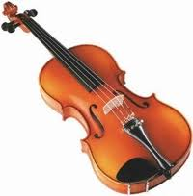
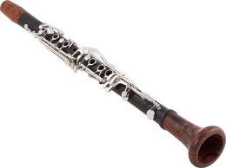
Fifty eight in a class. The ratio of the number of students who take piano lessons to violin lessons is 3:2. The ratio of the number of students who take violin lessons to clarinet lessons is 3:7. How many students take violin and clarinet lessons respectively?
Assume no student may play 2 or more instruments
Write out the Ratios:
Piano : Violin
Violin: Clarinet
Find a common denominator for 3 and 2
The number of students in each instrument will be
Piano : Violin : Clarinet
Piano : Violin : Clarinet

Slide 12
Two triangles share a common side. The side of one triangle are in the ratio 8 : 9 : 15 and the sides of the other triangle are in the ratio 7 : 10 : 12. Assuming that all of the sides of both triangles are of integral, what is the smallest possible length of the common side?

Slide 13
Q3: Two classes in an elementary school have both grades 6s and 7s. Class A is twice as big as class B. The ratio of grades 6 to 7 in Class A is 7 to 5 and in Class B is 2 to 3. What is the ratio of grades 6 to 7 altogether?

Slide 14
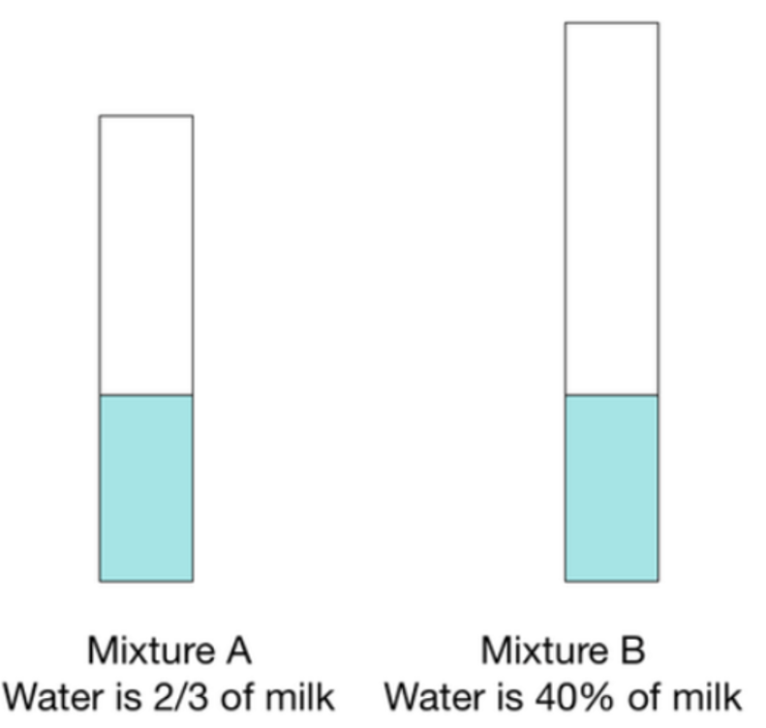
There are two vessels containing mixture of milk and water. In the first vessel the water is 2/3 of the milk. In the second vessel, the water is 40% of the milk. In what ratio should we mix these liquids to obtain a mixture with a water to milk ratio of 1:2?

